Slide 1
Topic: Graphing Exponentials
EQ: What are exponential function graphs?
Ms. Latham

Slide 2
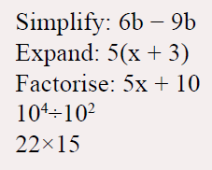
Warm Up Questions:
Topic: Graphing Exponentials
EQ: What are exponential function graphs?
Complete these 5 on your LHS without a calculator.

Slide 3
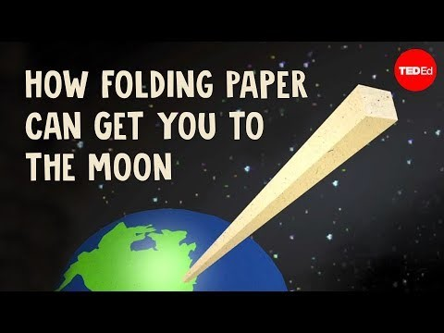
Think about how thick a piece of paper is….. If you fold it how thick will that be?
How many folds would it take to get to the moon?

Slide 4

Topic: Graphing Exponentials
EQ: What are exponential function graphs?
What is an Exponential function?
A function where the variable x is in the exponent.
Exponent (how many times the Base will be multiplied by itself)
$$y=a^{x}$$
Base
population growth
radioactive decay
bacteria
Every day applications
Science applications
Credit cards
Bank accounts
Loans
Hormone levels

Slide 5
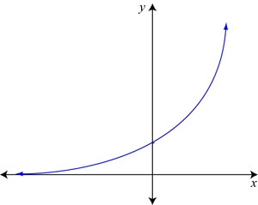

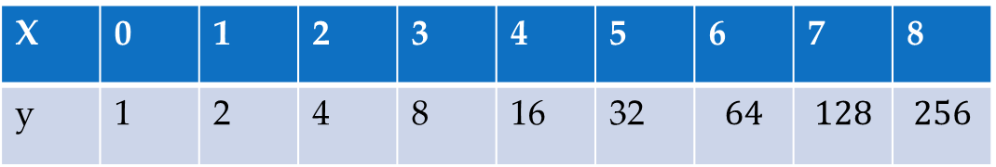
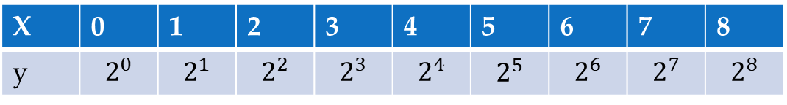
Topic: Graphing Exponentials
EQ: What are exponential function graphs?
Example 1
$$y=2^{x}$$
Base is 2 meaning each increase in x will be doubling y
X | 0 | 1 | 2 | 3 | 4 | 5 | 6 | 7 | 8
y | $$2^{0}$$ | $$2^{1}$$ | $$2^{2}$$ | $$2^{3}$$ | $$2^{4}$$ | $$2^{5}$$ | $$2^{6}$$ | $$2^{7}$$ | $$2^{8}$$
2×2×2 = 8
X | 0 | 1 | 2 | 3 | 4 | 5 | 6 | 7 | 8
y | 1 | 2 | 4 | 8 | 16 | 32 | $$64$$ | $$128$$ | $$256$$
The change gets larger and larger each time – the graph gets steeper as x increases.
The y values get very large, very fast

Slide 6
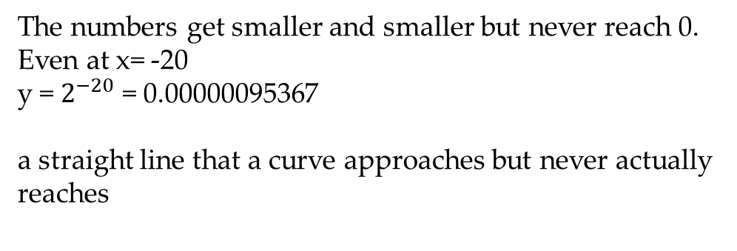
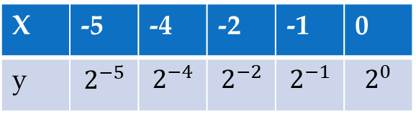
Topic: Graphing Exponentials
EQ: What are exponential function graphs?
Example 1
Let’s zoom in to the area that looks like the line is on the x-axis
$$y=2^{x}$$
X | -5 | -4 | -2 | -1 | 0
y | $$2^{−5}$$ | $$2^{−4}$$ | $$2^{−2}$$ | $$2^{−1}$$ | $$2^{0}$$
X | -5 | -4 | -2 | -1 | 0
y | 0.03125 | 0.125 | 0.25 | 0.5 | 1
The numbers get smaller and smaller but never reach 0. Even at x= -20
y = $2^{−20}$ = 0.00000095367
a straight line that a curve approaches but never actually reaches
When plotting exponentials choose a few x-values and connect with a curved line. Some x values will be hard to plot b/c too small or too big
Glossary Alert!
Asymptote

Slide 7


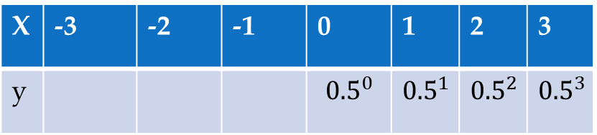
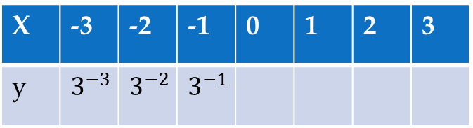
LHS - Practice Together
Complete the two tables
$$y=3^{x}$$
$$y={0.5}^{x}$$
X | -3 | -2 | -1 | 0 | 1 | 2 | 3
y | $$3^{−3}$$ | $$3^{−2}$$ | $$3^{−1}$$
X | -3 | -2 | -1 | 0 | 1 | 2 | 3
y |  |  |  | $${0.5}^{0}$$ | $${0.5}^{1}$$ | $${0.5}^{2}$$ | $${0.5}^{3}$$
X | -3 | -2 | -1 | 0 | 1 | 2 | 3
y | 0.037 | 0.111 | 0.333
X | -3 | -2 | -1 | 0 | 1 | 2 | 3
y |  |  |  |  | 0.5 | 0.25 | 0.125

Slide 8
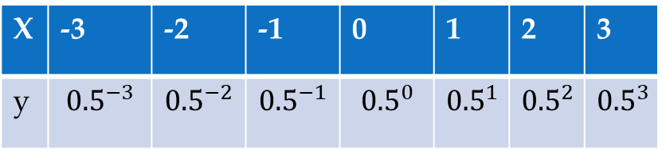
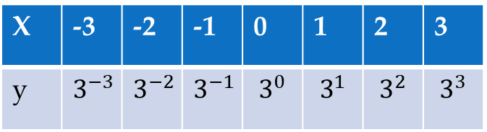
Practice Together
$$y=3^{x}$$
$$y={0.5}^{x}$$
X | -3 | -2 | -1 | 0 | 1 | 2 | 3
y | $$3^{−3}$$ | $$3^{−2}$$ | $$3^{−1}$$ | $$3^{0}$$ | $$3^{1}$$ | $$3^{2}$$ | $$3^{3}$$
X | -3 | -2 | -1 | 0 | 1 | 2 | 3
y | $${0.5}^{−3}$$ | $${0.5}^{−2}$$ | $${0.5}^{−1}$$ | $${0.5}^{0}$$ | $${0.5}^{1}$$ | $${0.5}^{2}$$ | $${0.5}^{3}$$
X | -3 | -2 | -1 | 0 | 1 | 2 | 3
y | 0.037 | 0.111 | 0.333 | 1 | 3 | 9 | 27
X | -3 | -2 | -1 | 0 | 1 | 2 | 3
y | 8 | 4 | 2 | 1 | 0.5 | 0.25 | 0.125

Slide 9
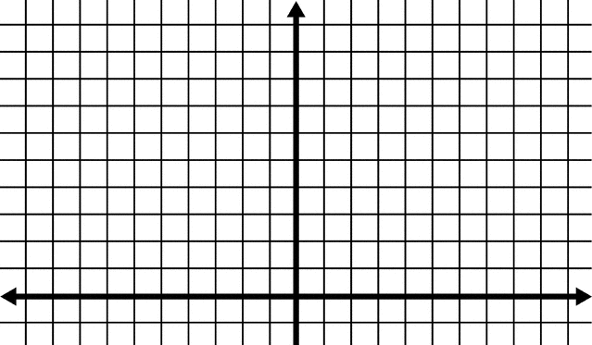
Practice Together
$$y=3^{x}$$
$$y={0.5}^{x}$$
X | -3 | -2 | -1 | 0 | 1 | 2 | 3
y | 0.037 | 0.111 | 0.333 | 1 | 3 | 9 | 27
X | -3 | -2 | -1 | 0 | 1 | 2 | 3
y | 8 | 4 | 2 | 1 | 0.5 | 0.25 | 0.125
Notes:
Pass out half sheets of graph paper.
They can graph it on the same graph using different colors.

Slide 10

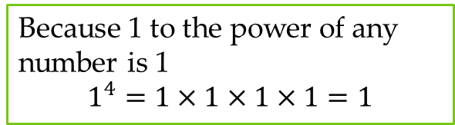
Topic: Graphing Exponentials
EQ: What are exponential function graphs?
$$y=a^{x}$$
If a is greater than 1: as a gets larger the line will increase quicker
If a is between 0 and 1: the line will be decreasing
a cannot be a negative number or 1
Changes to a (the Base)
Because 1 to the power of any number is 1
$$1^{4}=1×1×1×1=1$$

Slide 11

Task
$$y=5^{x}$$
X | -3 | -2 | -1 | 0 | 1 | 2 | 3
y
X | -3 | -2 | -1 | 0 | 1 | 2 | 3
y

Slide 12
Summary Sentence Frame
An exponential graph is _______________________. Some everyday uses include ________________________.
List 2 changes to the base:

